Slide 1












E-commerce Website
Made by- Rushil Adkane (RA2211026010260)
Rudraksh Agarwal (RA2211026010274)
Dev Lodhia (RA2211026010276)

Slide 2
ABSTRACT
This project aims to develop an electronics e-commerce website using Java, MySQL, and HTML. The website will have two main sections: a user page and an admin page.
The user page will allow users to browse and purchase electronic products. Users will be able to create an account, log in, view product details, add products to their cart, and checkout.
The admin page will allow administrators to manage the website's products and orders. Administrators will be able to add new products, edit existing products, delete products, and view orders.
The website will be implemented using Java servlets and JSPs. The database will be implemented using MySQL. The user interface will be implemented using HTML

Slide 3
Problem Statement
There are a number of problems with existing electronics e-commerce websites. One problem is that they can be difficult to use. Users may have difficulty finding the products they are looking for, and the checkout process can be cumbersome.

Slide 4
LITERATURE SURVEY
Several e-commerce websites have been developed using Java, MySQL, and HTML. These websites include:
Amazon.com
eBay.com
BestBuy.com
Walmart.com

Slide 5
Requirement Analysis
The electronics e-commerce website must meet the following requirements:
Users must be able to browse and purchase electronic products.
Users must be able to create an account, log in, view product details, add products to their cart, and checkout.
Administrators must be able to manage the website's products and orders.
Administrators must be able to add new products, edit existing products, delete products, and view orders.

Slide 6
ARCHITECTURE AND DESIGN
The electronics e-commerce website will be implemented using a three-tier architecture.
The first tier will be the presentation tier, which will be responsible for displaying the website to users.
The second tier will be the application tier, which will be responsible for processing user requests and managing the website's functionality.
The third tier will be the data tier, which will be responsible for storing and retrieving data.

Slide 7
The presentation tier will be implemented using HTML, CSS, and JavaScript.
The application tier will be implemented using Java servlets and JSPs.
The data tier will be implemented using MySQL.
The website will be deployed on a Tomcat server.

Slide 8
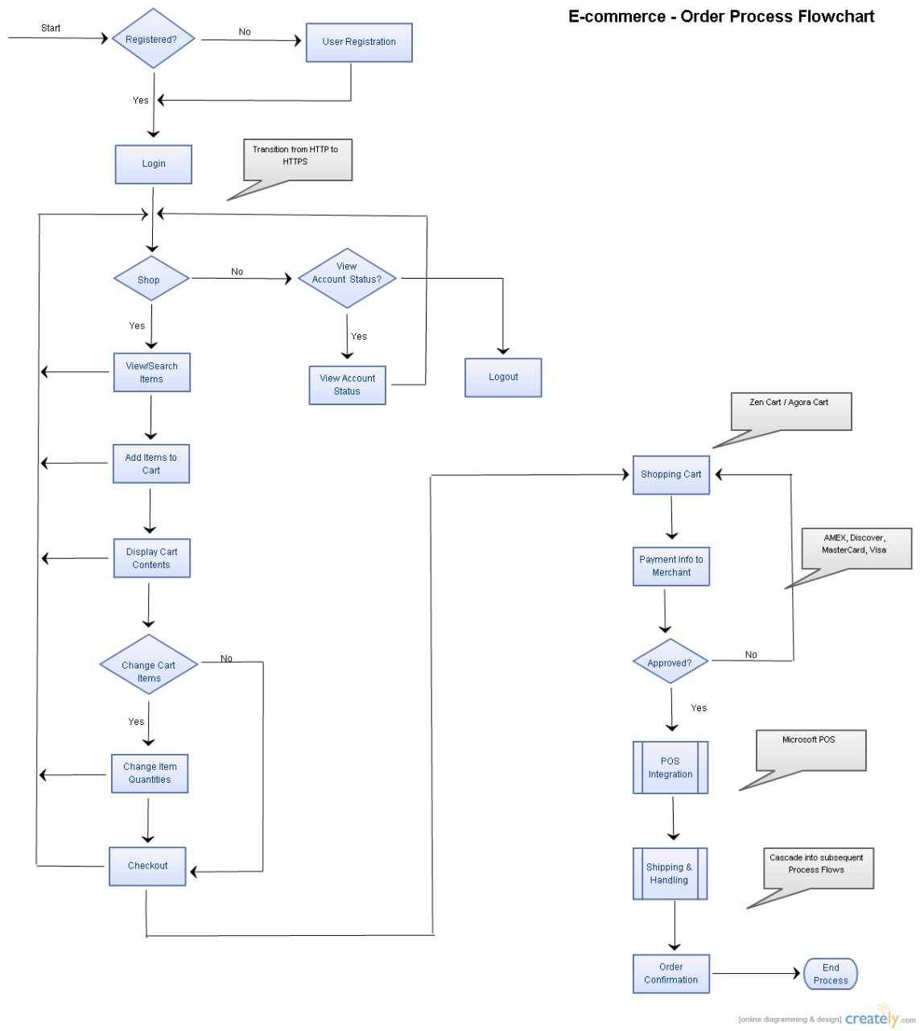
FLOWCHART

Slide 9
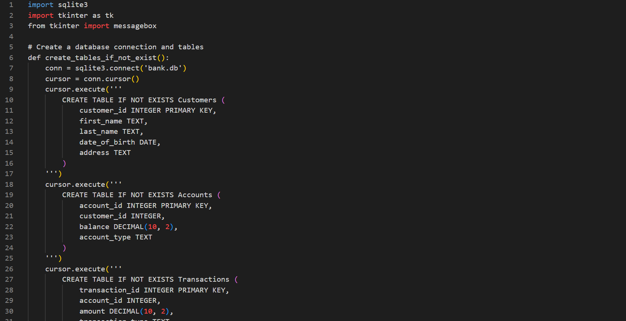
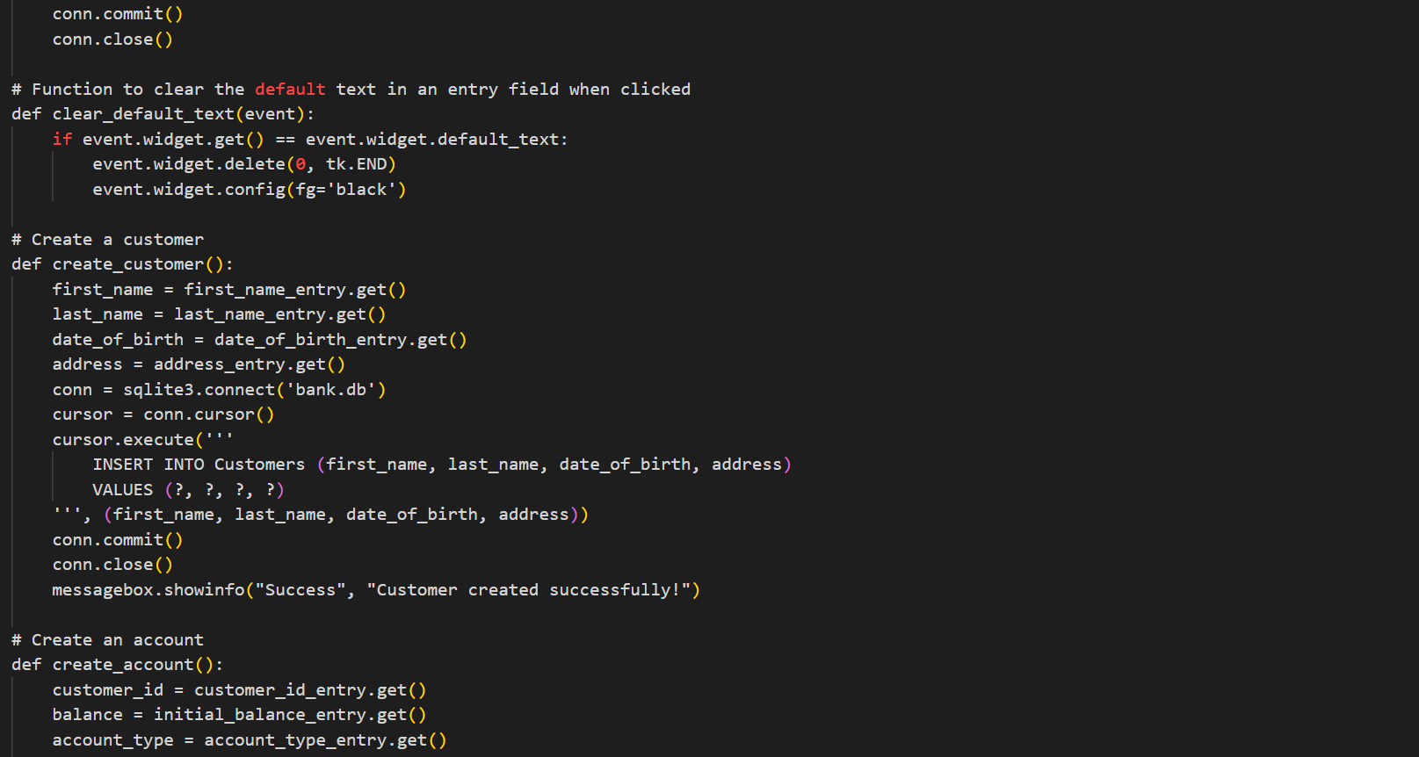
Code snippets

Slide 10
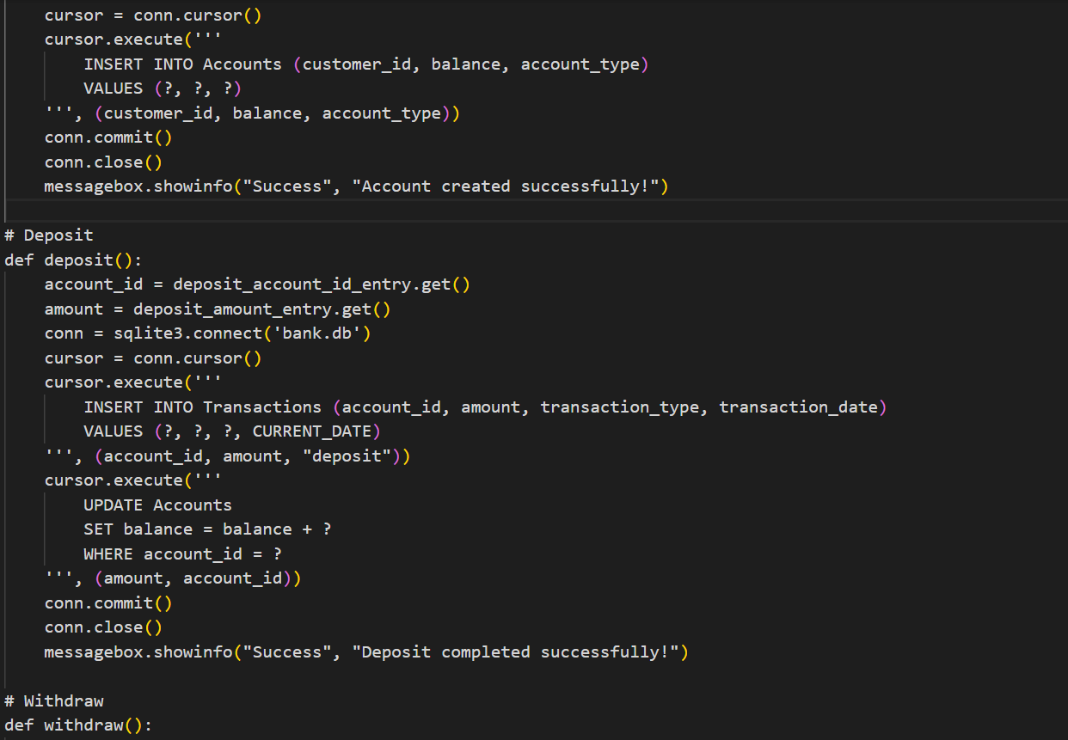
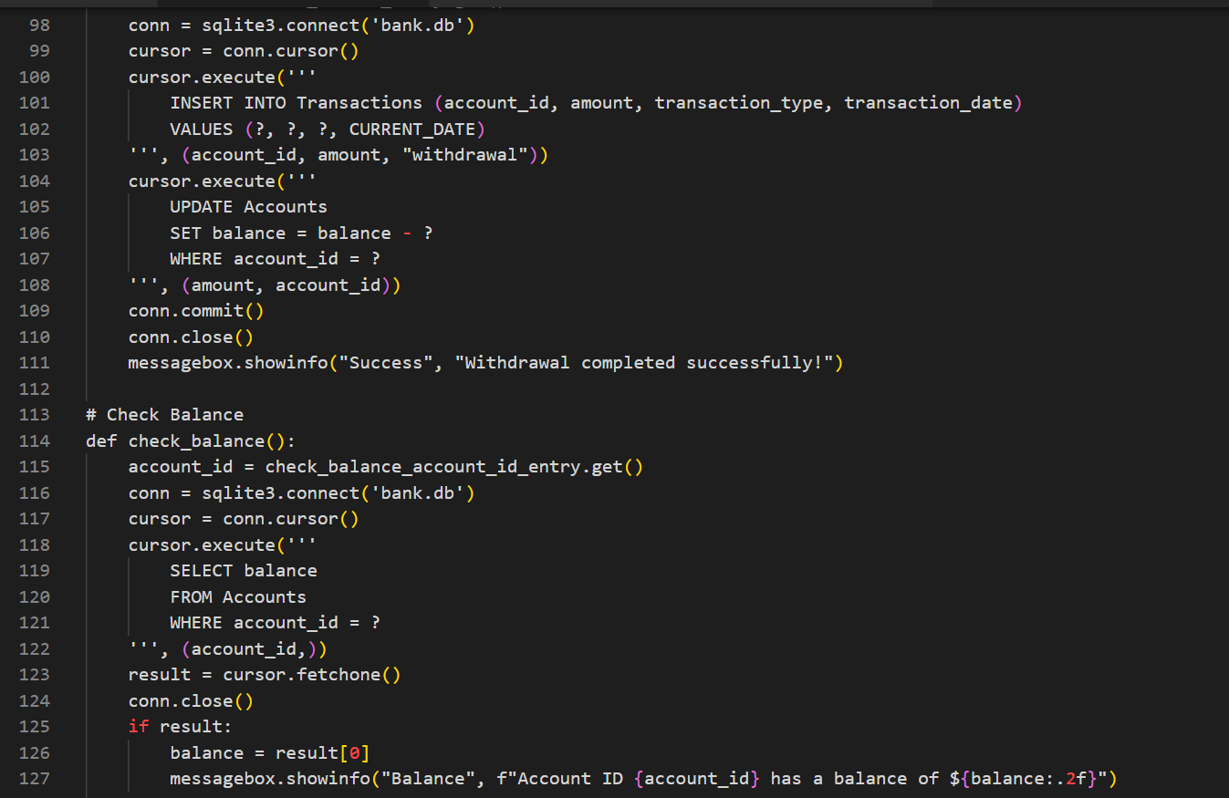



Slide 11
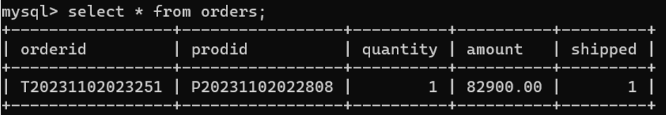
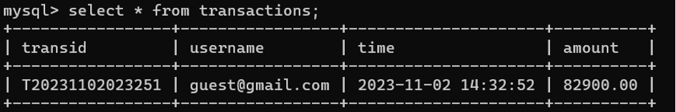
IMPLEMENTATION
Order Table
Transaction Table

Slide 12
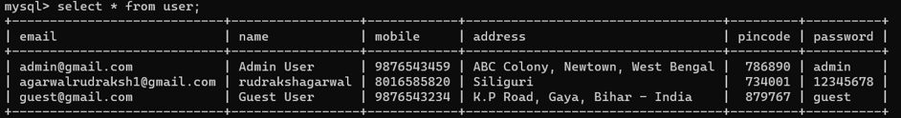
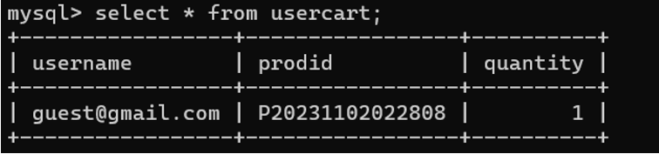
User Table
User Cart Table

Slide 13
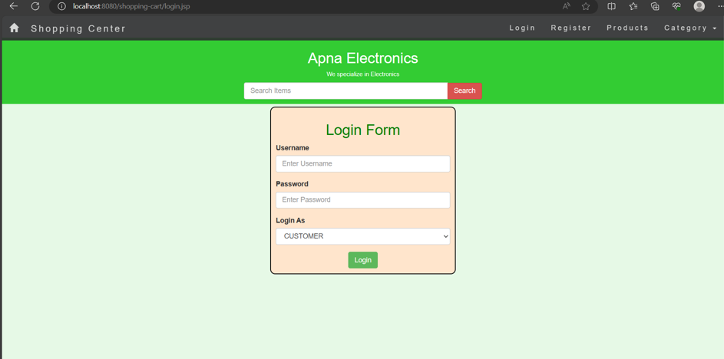
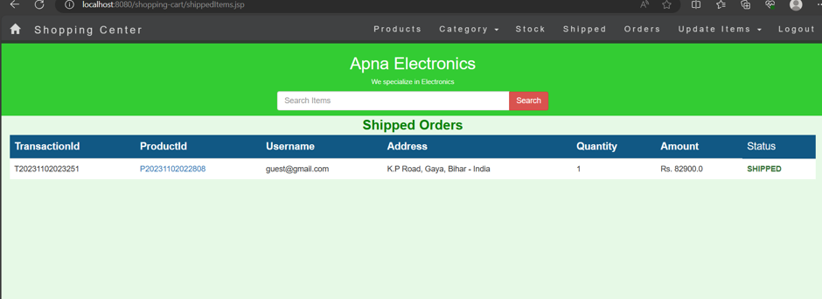
RESULTS

Slide 14
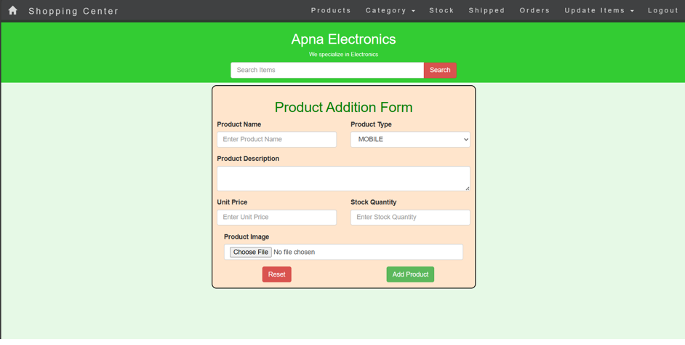
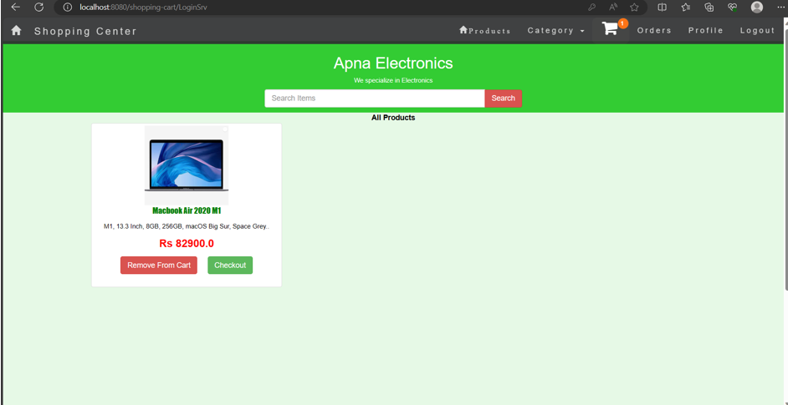
l
i

Slide 15
CONCLUSION
This project will develop a fully functional electronics e-commerce website using Java, MySQL, and HTML. The website will be beneficial for both users and administrators. The website will be implemented using open-source technologies, which will make it cost-effective and scalable.

Slide 16
THANK YOU!
t

